Slide 1



Myelodysplastic Syndromes:
Current Thinking on the Disease, Diagnosis and Treatment
Rafael Bejar MD, PhD
Aplastic Anemia & MDS International Foundation
Regional Patient and Family Conference
April 5th, 2014

Slide 2
Overview
Introduction to MDS
Pathophysiology
Clinical Practice
- Making the diagnosis
- Risk stratification
- Selecting therapy
Future Directions/Challenges

Slide 3
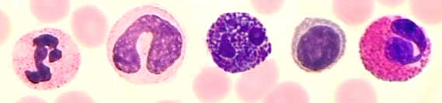
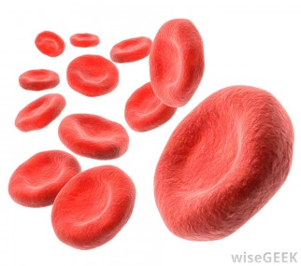
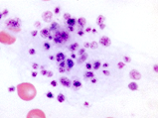
Low Blood Counts
65 year-old woman with mild anemia and a platelet count that fell slowly from 230 to 97 over the past 3 years.
Normal
Range

Slide 4
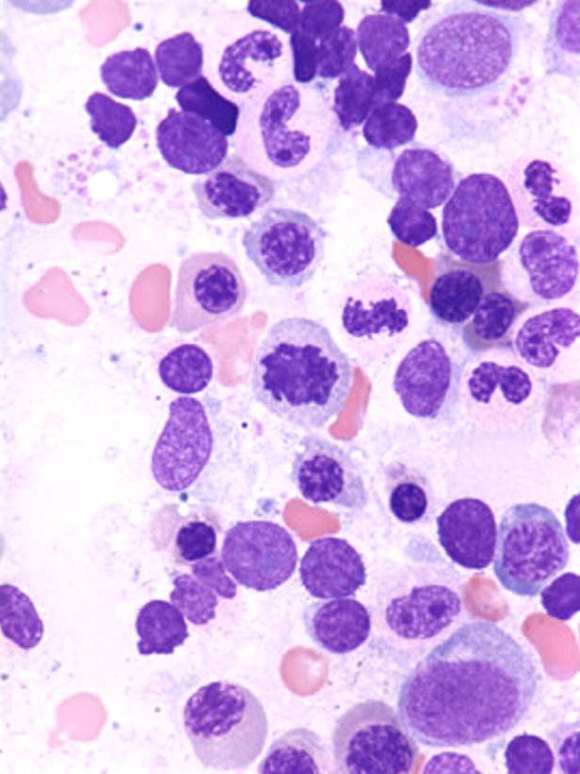
Myelodysplastic Syndromes
Shared features:
  Ineffective differentiation and low blood counts
  Clonal expansion of abnormal cells
  Risk of transformation to acute leukemia
Afflicts 15,000 – 45,000 people annually
Incidence rises with age (mean age 71)
ASH Image Bank

Slide 5
MDS Incidence Rates 2000-2008
US SEER Cancer Registry Data
http://seer.cancer.gov. Accessed May 1, 2013.

Slide 6
Age and Sex in MDS
Overall incidence in this analysis: 3.4 per 100,000
36.4*
50
Incidence rate (per 100,000)
Overall
Males
Females
40
20.9
30
20
7.5
10
2.0
0.1
0.7
0
< 40
40-49
50-59
60-69
70-79
≥ 80
Age at MDS diagnosis (years)
*P for trend < .05
Slide borrowed from Dr. David Steensma
Rollison DE et al Blood 2008;112:45-52.

Slide 7


Etiology of MDS
85%
10-15%
<5%
“De novo”
(idiopathic, primary)
Ionizing radiation,
DNA alkylating agents
(chlorambucil, melphalan, cyclophosphamide, etc.)
Topoisomerase II inhibitors
(etoposide, anthracyclines, etc.)
Median age ~71 years;
increased risk with aging
Peaks 5-7 years
following exposure
Peaks 1-3 years
following exposure
Slide borrowed from Dr. David Steensma

Slide 8
Risk factors for MDS
Environmental
Inborn
AGING
Fanconi anemia
Exposure to DNA alkylating agents (chlorambucil, melphalan, cyclophosphamide)
Familial Platelet Disorder with AML Predisposition (“FPD-AML”) (RUNX1, CEBPA)
GATA2 mutant
(MonoMACsyndrome: monocytopenia, B/NK lymphopenia, atypical mycobacteria and viral and other infections, pulmonary proteinosis, neoplasms)
Exposure to topoisomerase II inhibitors (etoposide, anthracyclines)
Exposure to ionizing radiation
Environmental / occupational exposures (hydrocarbons etc.)
Other congenital marrow failure syndromes or DNA repair defects (Bloom syndrome, ataxia-telangiectasia, etc.)
Antecedent acquired hematological disorders
Aplastic anemia (15-20%)
Familial syndromes of unknown origin
PNH (5-25%)
Slide borrowed from Dr. David Steensma

Slide 9
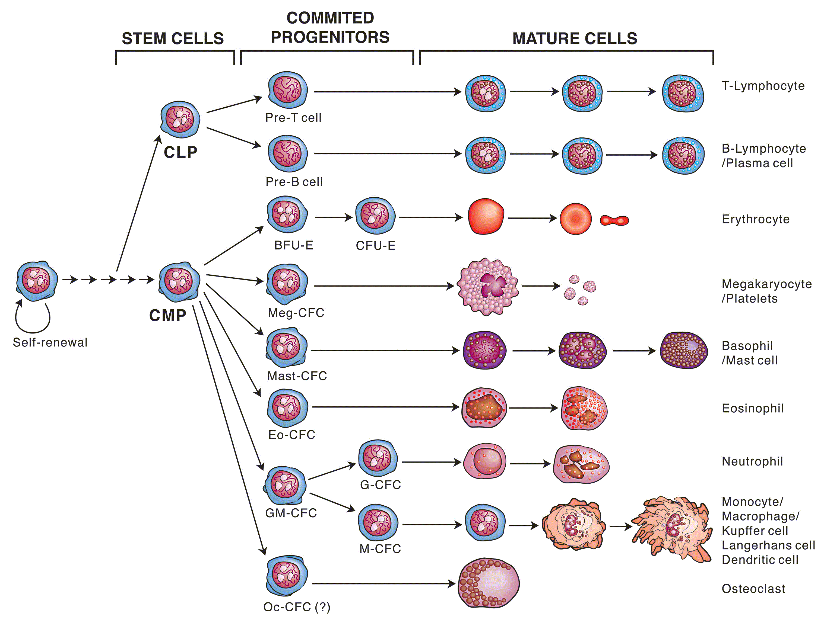
Corrupted Hematopoiesis

Slide 10
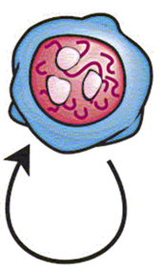
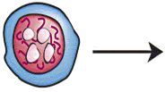
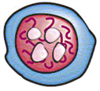
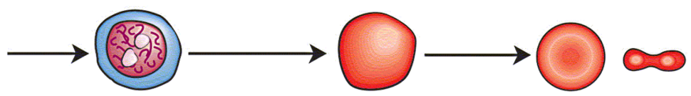


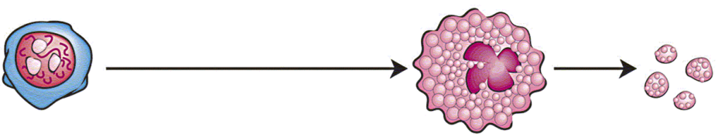

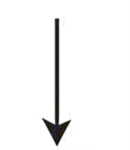


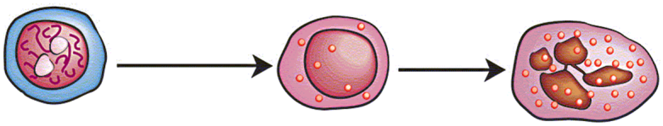


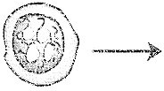
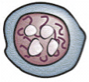
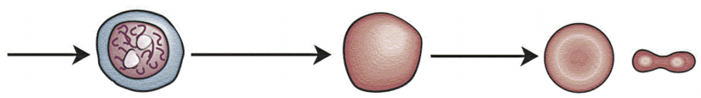

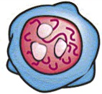
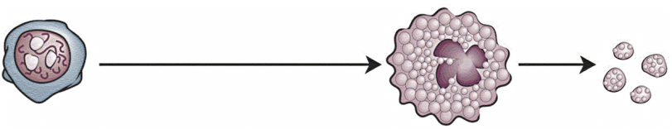
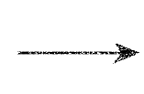

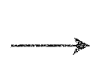
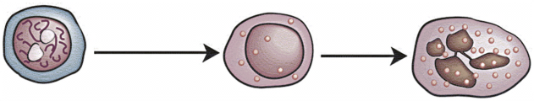





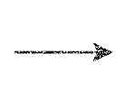



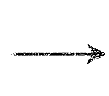



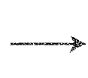
Differentiation
Normal
Early
MDS
Transformation
Advanced
MDS
Secondary AML

Slide 11
Making the Diagnosis

Slide 12
Diagnostic Overlap
Fanconi
Anemia
Acute Myeloid
Leukemia (AML)
Aplastic Anemia
Myelodysplastic
Syndromes (MDS)
Myeloproliferative
Neoplasms
Paroxysmal
Nocturnal
Hematuria
T-LGL

Slide 13

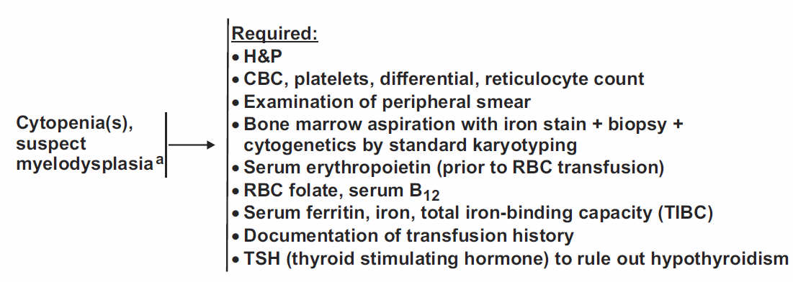
Myelodysplastic Syndromes

Slide 14
Minimum Evaluation Needed
Diagnosis of MDS is largely MORPHOLOGIC, so you need is:
      Bone Marrow Aspirate/Biopsy
      Complete Blood Count with white cell differential
      Karyotype (chromosome analysis)
Sometimes useful:
      MDS FISH panel – usually if karyotype fails
      Flow cytometry – aberrant immunophenotype
      Genetic Testing – may become standard eventually

Slide 15
Minimal Diagnostic Criteria
Cytopenia(s):
Hb <11 g/dL, or
ANC <1500/μL, or
Platelets <100 x 10⁹L
MDS “decisive” criteria:
  >10% dysplastic cells in 1 or more lineages, or
  5-19% blasts, or
  Abnormal karyotype typical for MDS, or
  Evidence of clonality (by FISH or another test)
Other causes of cytopenias and morphological changes EXCLUDED:
Vitamin B12/folate deficiency
HIV or other viral infection
Copper deficiency
Alcohol abuse
Medications (esp. methotrexate, azathioprine, recent chemotherapy)
Autoimmune conditions (ITP, Felty syndrome, SLE etc.)
Congenital syndromes (Fanconi anemia etc.)
Other hematological disorders (aplastic anemia, LGL disorders, MPN etc.)
Valent P, et al. Leuk Res. 2007;31:727-736.
Slide borrowed from Dr. David Steensma
Valent P et al Leuk Res 2007;31:727-736.

Slide 16
Looking for Answers
65 year-old woman with mild anemia and a platelet count that fell slowly from 230 to 97 over the past 3 years.
B12 level - Normal
Folate - Normal
Thyroid - Normal
No toxic medications
No alcohol use
No chronic illness
Normal
Range

Slide 17

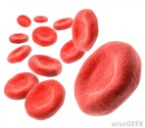

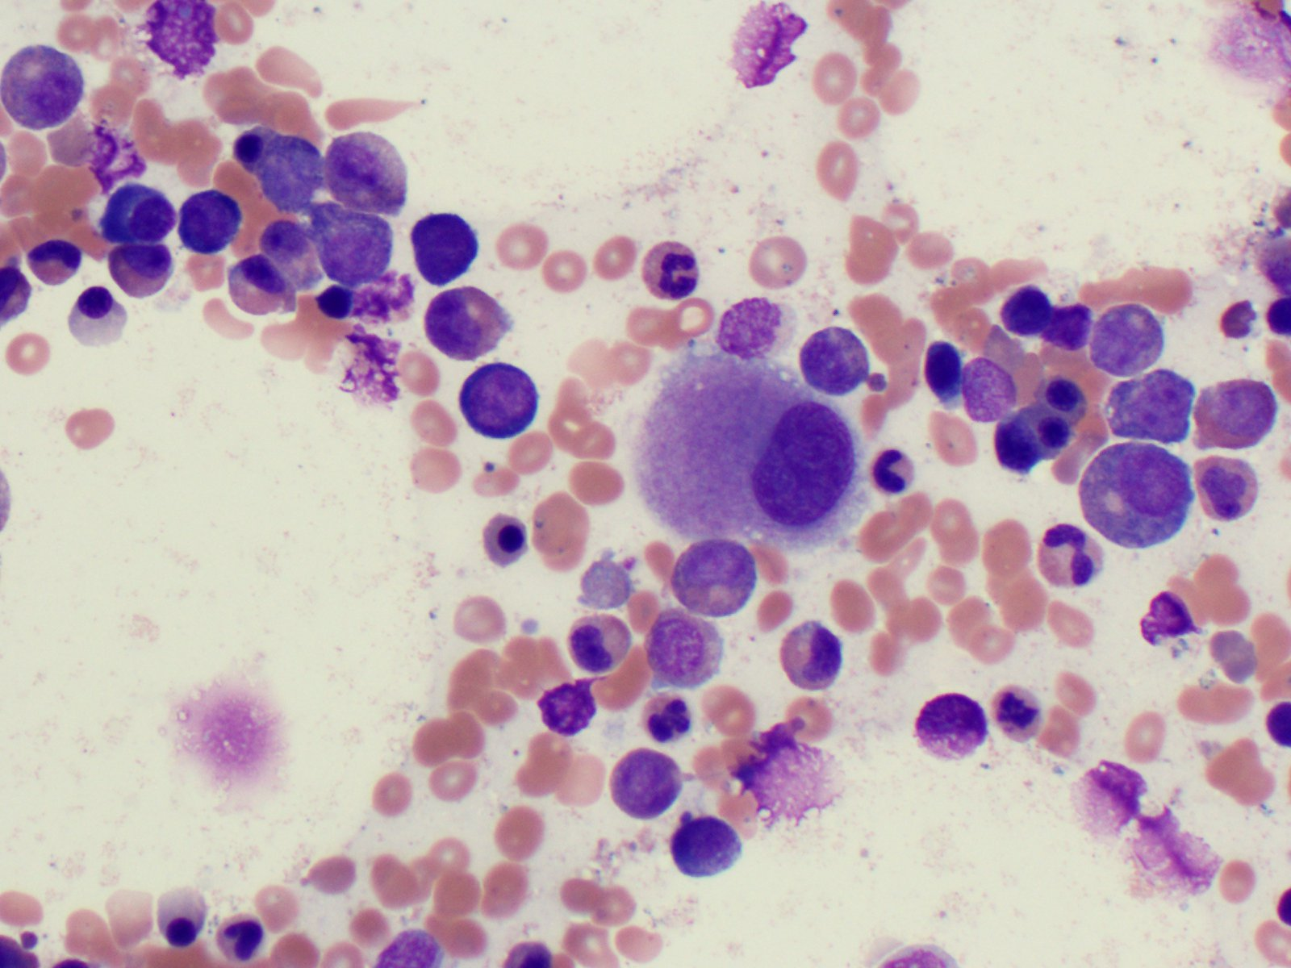
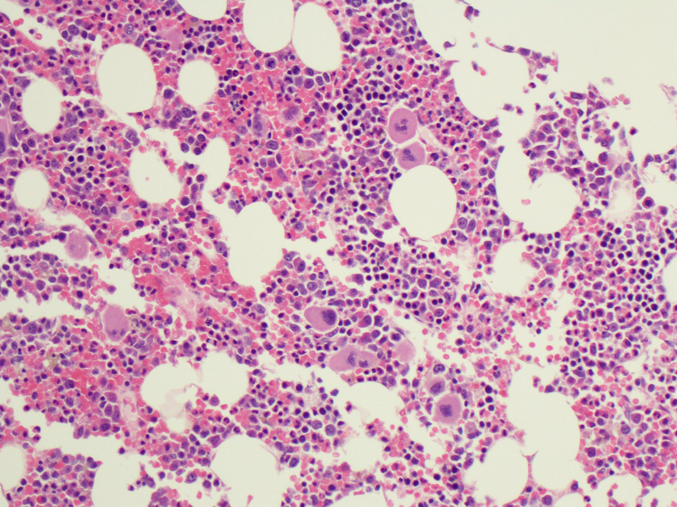
Bone Marrow Biopsy
65 year-old woman with mild anemia and a platelet count that fell slowly from 230 to 97 over the past 3 years.
Too many cells in the bone marrow
No extra ‘blasts’ seen
Chromosomes are NORMAL

Slide 18
Classification of MDS Subtypes

Slide 19
World Health Organization MDS categories (2008)
Name | Abbreviation | Blood findings | Bone Marrow findings
Refractory cytopenia with unilineage dysplasia (RCUD) | Refractory anemia (RA) | Unicytopenia; occasionally bicytopenia No or rare blasts (<1%) | Unilineage dysplasia (≥10% of cells in one myeloid lineage) <5% blasts <15% of erythroid precursors are ring sideroblasts
 | Refractory neutropenia (RN)
 | Refractory thrombocytopenia (RT)
Refractory anemia with ring sideroblasts | RARS | Anemia No blasts | ≥15% of erythroid precursors are ring sideroblasts Erythroid dysplasia only <5% blasts
MDS associated with isolated del(5q) | Del(5q) | Anemia Usually normal or increased platelet count No or rare blasts (<1%) | Isolated 5q31 deletion Normal to increased megakaryocytes with hypolobated nuclei <5% blasts No Auer rods
Refractory cytopenia with multilineage dysplasia | RCMD | Cytopenia(s) No or rare blasts (<1%) No Auer rods <1 x 10⁹/L monocytes | ≥10% of cells in ≥2 myeloid lineages dysplastic <5% blasts No Auer rods ±15% ring sideroblasts
Refractory anemia with excess blasts, type 1 | RAEB-1 | Cytopenia(s) <5% blasts No Auer rods <1 x 10⁹/L monocytes | Unilineage or multilineage dysplasia 5-9% blasts No Auer rods
Refractory anemia with excess blasts, type 2 | RAEB-2 | Cytopenia(s) 5-19% blasts ±Auer rods <1 x 10⁹/L monocytes | Unilineage or multilineage dysplasia 10-19% blasts ±Auer rods
MDS - unclassified | MDS-U | Cytopenia(s) ≤1% blasts | Minimal dysplasia but clonal cytogenetic abnormality considered presumptive evidence of MDS <5% blasts
Swerdlow SH, Campo E, et al, eds. WHO Classification of Tumours of Haematopoietic and Lymphoid Tissues, 4th edition.
Lyon: IARC Press, 2008, page 89 (Section: Brunning RD et al, “Myelodysplastic syndromes/neoplasms, overview)”.

Slide 20
World Health Organization MDS/MPN categories (2008)
Name | Abbreviation | Blood findings | Bone Marrow findings
Refractory anemia with ring sideroblasts and thrombocytosis | RARS-T | Anemia No blasts ≥450 x 10⁹/L platelets | ≥15% of erythroid precursors are ring sideroblasts Erythroid dysplasia only <5% blasts proliferation of large megakaryocytes
Chronic myelomonocytic leukemia, type 1 | CMML-1 | >1 x 10⁹/L monocytes <5% blasts | Unilineage or multilineage dysplasia <10% blasts
Chronic myelomonocytic leukemia, type 2 | CMML-2 | >1 x 10⁹/L monocytes 5%-19% blasts or Auer rods | Unilineage or multilineage dysplasia 10%-19% blasts or Auer rods
Atypical chronic myeloid leukemia | aCML | WBC > 13 x 10⁹/L Neutrophil precursors >10% <20% blasts | Hypercellular <20% blasts BCR-ABL1 negative
Juvenile myelomonocytic leukemia | JMML | >1 x 10⁹/L monocytes <20% blasts | Unilineage or multilineage dysplasia <20% blasts BCR-ABL1 negative
MDS/MPN – unclassified (‘Overlap Syndrome’) | MDS/MPN-U | Dysplasia with myeloproliferative features No prior MDS or MPN | Dysplasia with myeloproliferative features
Swerdlow SH, Campo E, et al, eds. WHO Classification of Tumours of Haematopoietic and Lymphoid Tissues, 4th edition.
Lyon: IARC Press, 2008, page 89 (Section: Brunning RD et al, “Myelodysplastic syndromes/neoplasms, overview)”.

Slide 21
Genetic Abnormalities in MDS
Translocations /
Rearrangements
Rare in MDS:
t(6;9)
i(17q)
t(1;7)
t(3;?)
t(11;?)
inv(3)
idic(X)(q13)
Uniparental disomy /
Microdeletions
Rare - often at sites of point mutations:
4q TET2
7q EZH2
11q CBL
17p TP53
Copy Number Change
About 50% of cases:
del(5q)
-7/del(7q)
del(20q)
del(17p)
del(11q)
del(12p)
+8
-Y
Point Mutations
Most common:
Likely in all cases
~80% of cases have mutations in a known gene
Observed Frequency in MDS

Slide 22
Point Mutations in MDS
Tyrosine Kinase Pathway
Transcription Factors
Others
JAK2
KRAS
BRAF
RUNX1
TP53
NPM1
GATA2
ETV6
CALR
BRCC3
GNAS/GNB1
Cohesins
NRAS
RTK’s
PTPN11
WT1
PHF6
BCOR
CBL
Epigenetic Dysregulation
Splicing Factors
DNMT3A
EZH2
U2AF1
ZRSF2
IDH
1 & 2
SF3B1
SETBP1
PRPF40B
TET2
U2AF2
ASXL1
SRSF2
UTX
PRPF8
SF1
ATRX
SF3A1

Slide 23
Prognostic Risk Assessment

Slide 24

MDS Risk Assessment
65 year-old woman with mild anemia and a platelet count that fell slowly from 230 to 97 over the past 3 years.
Diagnosis:
Refractory cytopenia with unilineage dysplasia
Normal
Range

Slide 25
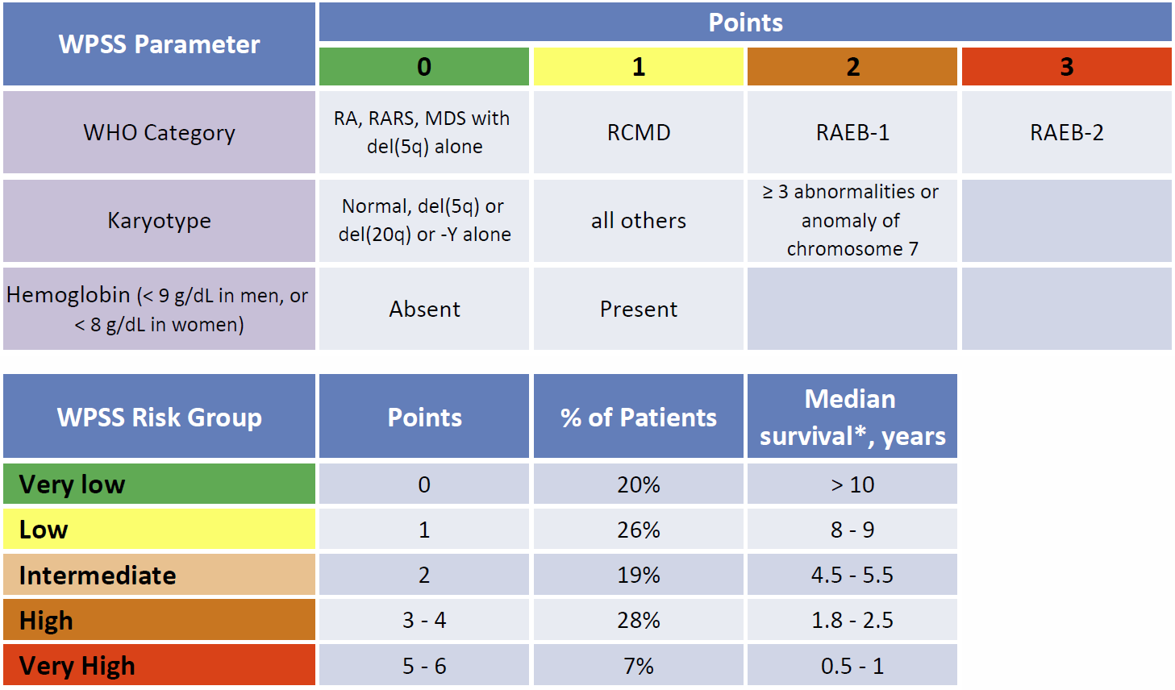
WHO Prognostic Scoring System
*Median survival ranges for the WPSS were estimated from Malcovati et al. Haematologica. 2011 Oct;96(10):1433-40
Malcovati et al. Haematologica. 2011;96:1433-40.
Notes:
MN comments (NCCN GL): Added reference citation for WPSS. Note to presenter: there is no information or footnote that corresponds to the asterisk on ‘Median survival’ in the second table in the slide.

Slide 26
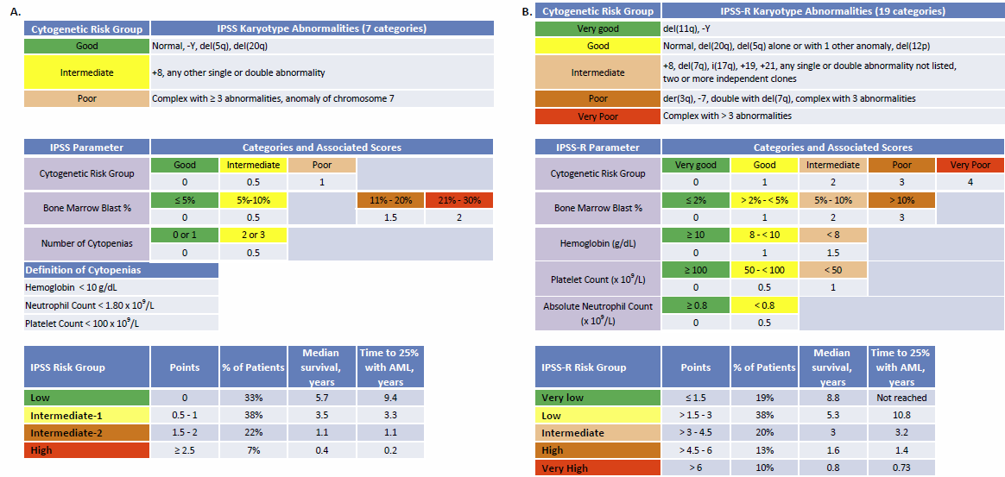
International Prognostic Scoring System
Greenberg et al. Blood. 1997;89:2079-88.
Notes:
MN comments (NCCN GL): Added reference citations for IPSS and IPSS-R.

Slide 27
IPSS-Revised (IPSS-R)
ipss-r.com
Greenberg et al. Blood. 2012:120:2454-65.
Notes:
MN comments (NCCN GL): Added reference citations for IPSS and IPSS-R.

Slide 28
MDS Risk Assessment
65 year-old woman with mild anemia and a platelet count that fell slowly from 230 to 97 over the past 3 years.
Diagnosis:
Refractory cytopenia with unilineage dysplasia
WPSS - Very Low Risk
IPSS - Low Risk
IPSS-R - Very Low Risk
Normal
Range

Slide 29
Risk Adapted Therapy

Slide 30
Treatment Options for MDS
Observation
Erythropoiesis stimulating agents
Granulocyte colony stimulating factor
Iron chelation
Red blood cell transfusion
Platelet transfusion
Lenalidomide
Immune Suppression
Hypomethylating agent
Stem cell transplantation
Clinical Trials – always the best option
Options

Slide 31
MDS Risk Assessment
65 year-old woman with mild anemia and a platelet count that fell slowly from 230 to 97 over the past 3 years.
Diagnosis:
Refractory cytopenia with unilineage dysplasia
WPSS - Very Low Risk
IPSS - Low Risk
IPSS-R - Very Low Risk
Normal
Range

Slide 32
Treating Lower Risk MDS
Primary Goal: to improve QUALITY OF LIFE
Do I need to treat at all?
- No advantage to early aggressive treatment
- Observation is often the best approach
2. Are transfusions treatment?
- No! They are a sign that treatment is needed.

Slide 33
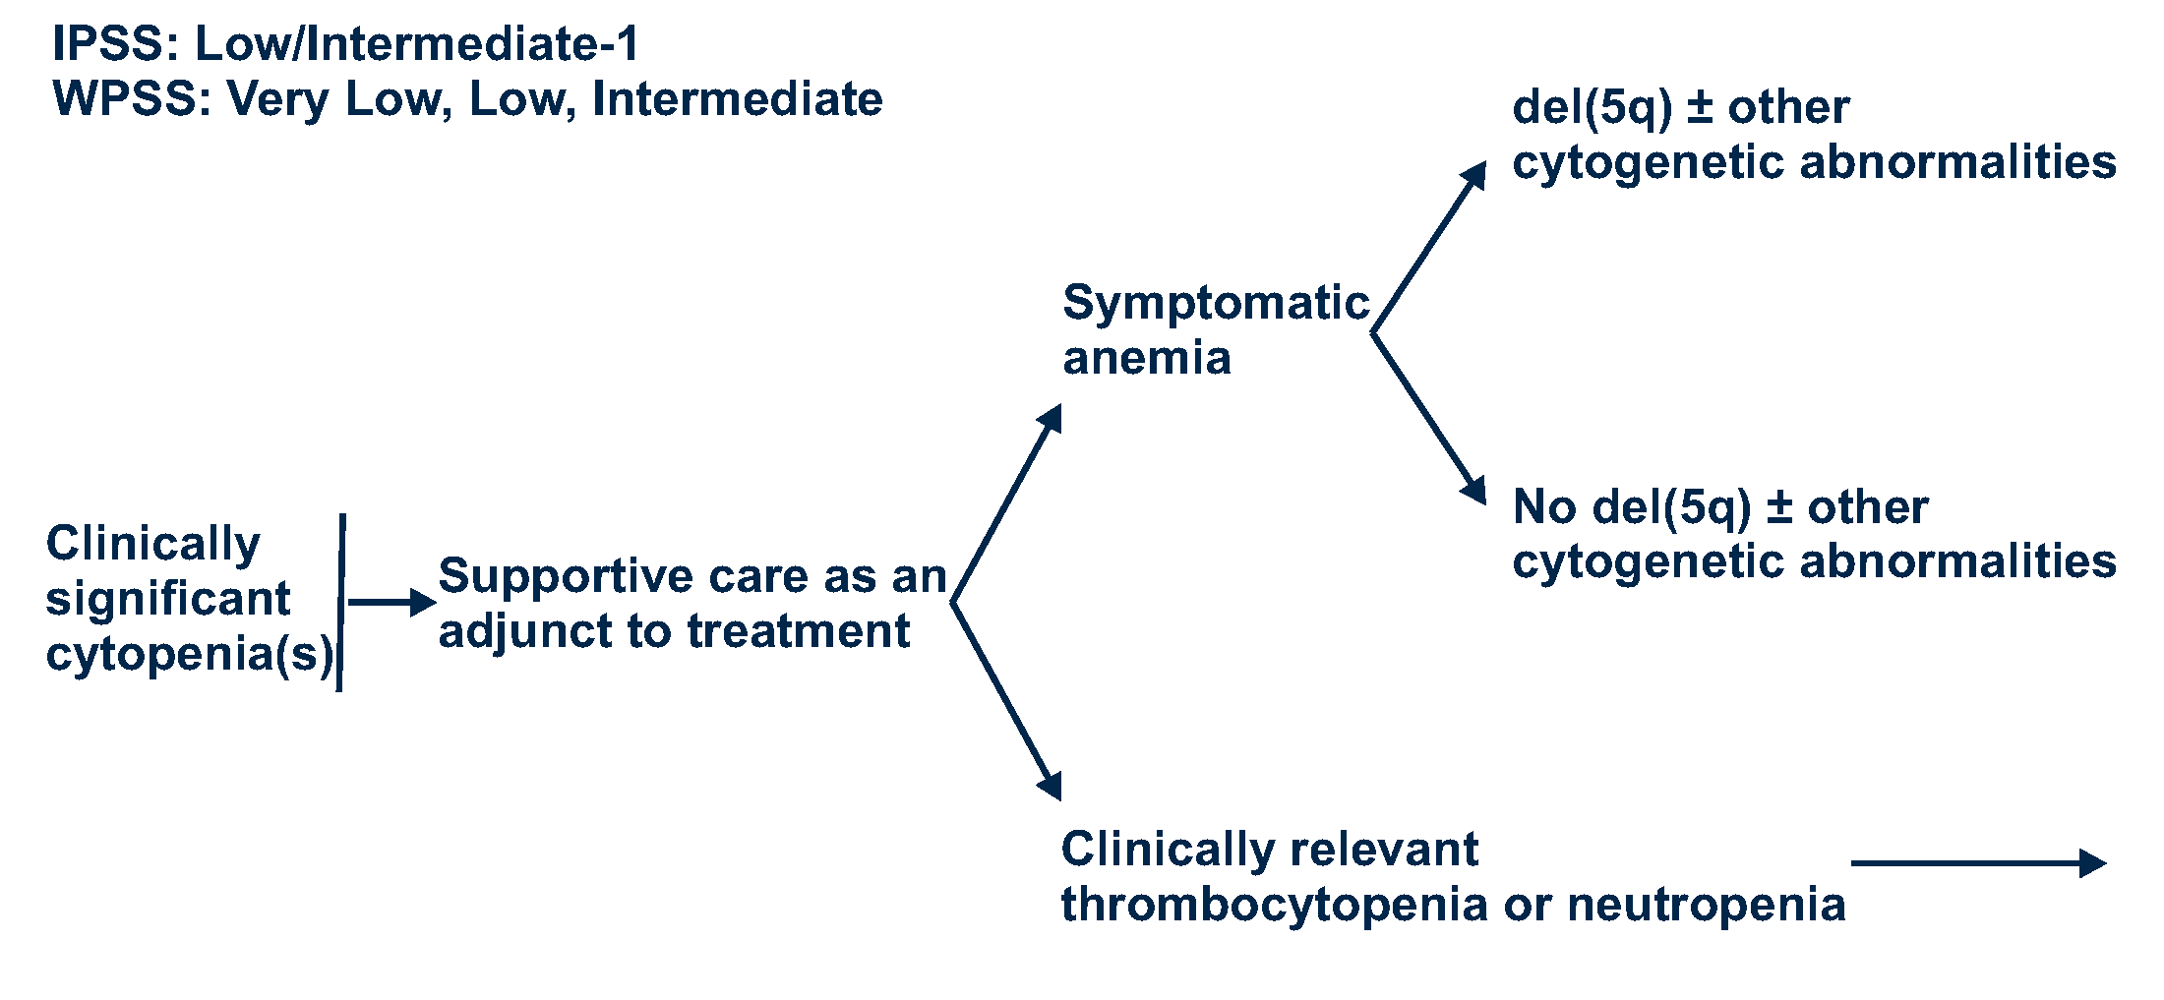
Guidelines for Lower Risk MDS
Primary Goal: to improve QUALITY OF LIFE

Slide 34
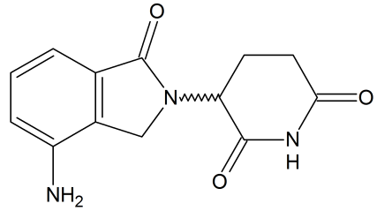
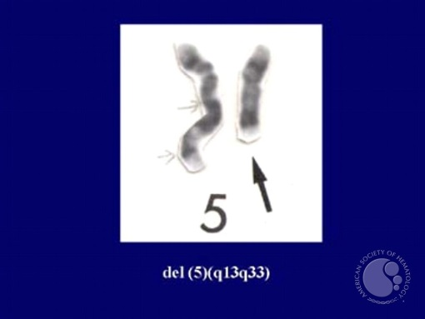
Treating Lower Risk MDS
Primary Goal: to improve QUALITY OF LIFE
What if treatment is needed?
Is my most effective therapy likely to work?
- Lenalidomide (Revlimid)
In del(5q) – response rates are high
  50%-70% respond to treatment
  Median 2-years transfusion free!

Slide 35
Treating Lower Risk MDS
Primary Goal: to improve QUALITY OF LIFE
Is my second most effective therapy likely to work?
- Red blood cell growth factors
- Erythropoiesis Stimulating Agents (ESAs)
- Darbepoetin alfa (Aranesp)
- Epoetin alfa (Procrit, Epogen)
- Lance Armstrong Juice → EPO

Slide 36
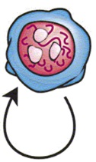










Erythropoiesis Stimulating Agents
Primary Goal: to improve QUALITY OF LIFE
ESAs
TPO mimetics
G-CSF (neupogen)
ESAs – act like our own erythropoietin
Serum EPO level (U/L) | RBC transfusion requirement
<100 = +2 pts | <2 Units / month = +2 pts
100-500 = +1 pt | ≥2 Units / month = -2 pts
>500 = -3 pts
Total Score | Response Rate
High likelihood of response: > +1 | 74% (n=34)
Intermediate likelihood: -1 to +1 | 23% (n=31)
Low likelihood of response: < -1 | 7% (n=39)
Hellstrom-Lindberg E et al Br J Haem 2003; 120:1037

Slide 37
Growth Factor Combinations
Primary Goal: to improve QUALITY OF LIFE
ESAs
TPO mimetics
G-CSF (neupogen)
ESAs can be combined with G-CSF
- response rate of 46.6%, EPO <200 and <5% blasts predictive
ESAs can be combined with Lenalidomide
- response rate of 31% to Len, 52% to both. TI 18.4% vs. 32.0%!
ESAs can be combined with Azacitidine – not yet standard
Greenberg, P. L., Z. Sun, et al. (2009) Blood 114(12): 2393-2400.
Toma A et al (ASCO Abstract) J Clin Oncol 31, 2013 (suppl; abstr 7002)

Slide 38
Thrombopoietin Mimetics
Primary Goal: to improve QUALITY OF LIFE
ESAs
TPO mimetics
G-CSF (neupogen)
Eltrombopag and Romiplostim - approved, but not in MDS
Initial concern about increasing blasts and risk of AML
Follow-up suggests Romiplostim safe in lower risk patients
Mittleman M et al ASH Abstracts, 2013. Abstract #3822
Kantarjian H et al ASH Abstracts, 2013. Abstract #421

Slide 39
Treating Lower Risk MDS
Primary Goal: to improve QUALITY OF LIFE
What my next most effective therapy?
- Immunosuppression
Some MDS patients have features of aplastic anemia
- Hypoplastic bone marrow (too few cells)
- PNH clones
- Certain immune receptor types (HLA-DR15)

Slide 40
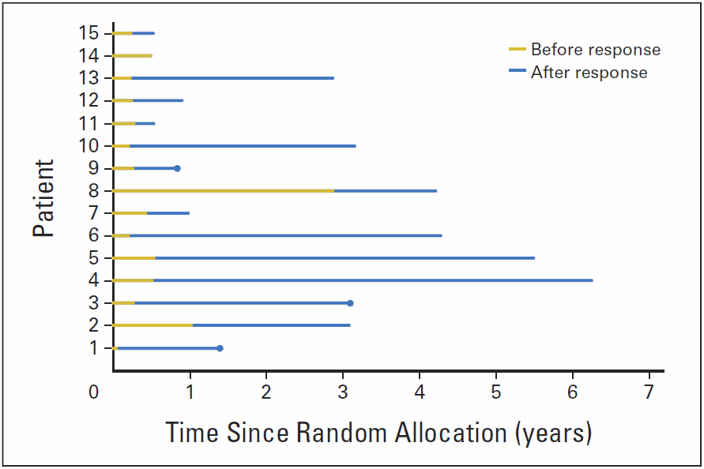
Immune Suppression for MDS
Primary Goal: to improve QUALITY OF LIFE
  Swiss/German Phase III RCT of ATG + Cyclosporin (88 patients)
  Mostly men with Lower Risk MDS
  CR+PR: 29% vs. 9%
  No effect on survival
  Predictors of Response:
  - hypocellular aspirate
  - lower aspirate blast %
  - younger age
  - more recent diagnosis
Passweg, J. R., A. A. N. Giagounidis, et al. (2011). JCO 29(3): 303-309.

Slide 41
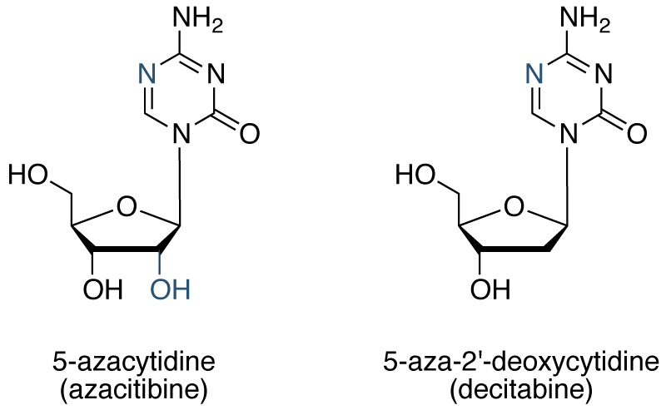
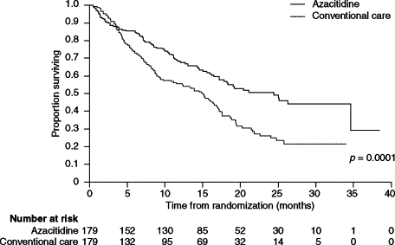
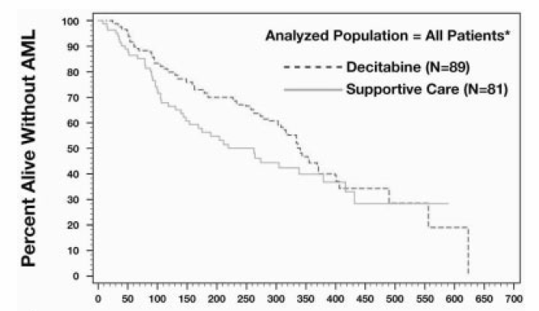
Hypomethylating Agents
  Inhibitors of DNA methyl transferases:

Slide 42
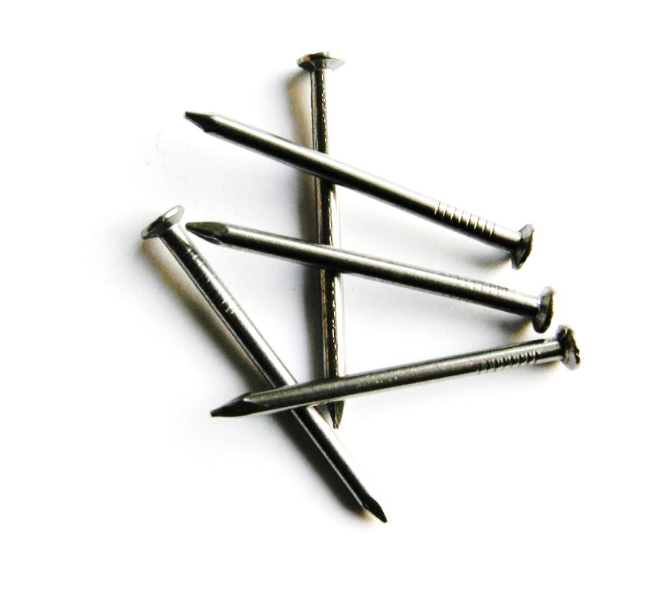
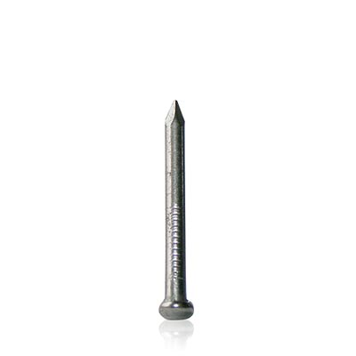
Iron Balance and Transfusions
Daily intake
1.5 mg (0.04%)
Tightly regulated
Daily losses only
1.5 mg (0.04%)
Not regulated!
3-4 grams of Iron
in the body
Every three
units of blood

Slide 43
What About Iron Chelation?
  More transfusions and elevated ferritin levels are associated with poor outcomes in MDS patients.
  Are these drivers of prognosis or just reflective of disease?
  Retrospective studies suggest survival advantage!
    small prospective and large population based Medicare studies show survival benefit, INCLUDING hematologic responses (11-19%).
  I consider treatment in lower risk, transfusion dependent patients with long life expectancy after 20+ transfusions.
Zeidan et al. ASH Meeting. 2012. Abstract #426.
Nolte et al. Ann Hematol. 2013. 92(2):191-8.

Slide 44
How to Chelate Iron
  Three ways are FDA approved:
  Deferoxamine (Desferal) – subcutaneous pump 8-12 hrs/day
  Deferasirox (Exjade) – oral suspension – once per day
  Deferiprone (Ferriprox) – oral pill form – 3x per day
  But side effects and adverse events can be significant!
  Deferasirox – renal, hepatic failure and GI bleeding
  Deferiprone – agranulocytosis (no neutrophils!)

Slide 45
Guidelines for Lower Risk MDS
Primary Goal: to improve QUALITY OF LIFE
Do I need to treat? - symptomatic cytopenias
Is LEN likely to work? - del(5q) ±
Are ESA likely to work? - Serum EPO < 500
Is IST likely to work? - hypocellular, DR15, PNH
Think about iron! - 20 or more transfusions
Consider AZA/DEC
Consider HSCT or clinical trial!

Slide 46
Guidelines for Lower Risk MDS
Special Considerations:
Transfusion Dependence
- Indication for treatment – even with AZA/DEC, consider chelation
Del(5q)
- High response rate to LEN even if other abnormalities
Serum EPO level
- Used to predict EPO response, > 500 → unlikely to work
Indication for G-CSF
- used to boost EPO, not for primary neutropenia
Immunosuppresive Therapy
- ≤ 60y, hypocellular marrow, HLA-DR15+, PNH clone

Slide 47
Future Directions

Slide 48
Limitations of the IPSS/IPSS-R
  Less than half of patients have relevant cytogenetic abnormalities
  Heterogeneity remains within each risk category, particularly the lower-risk categories
  Excludes therapy related disease and CMML
  Is only validated at the time of initial diagnosis in untreated patients
  The IPSS’s do not include molecular abnormalities

Slide 49
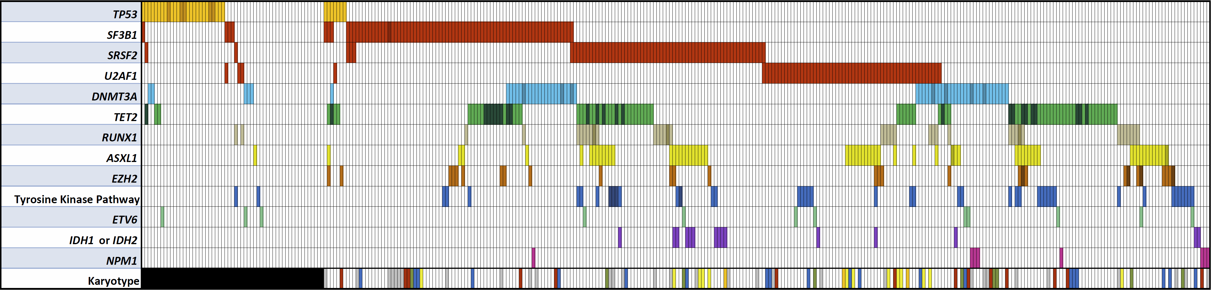
Mutation Frequency and Distribution
Complex (3 or more abnormalities)
Bejar et al. NEJM. 2011;364:2496-506.
Bejar et al. JCO. 2012;30:3376-82.

Slide 50
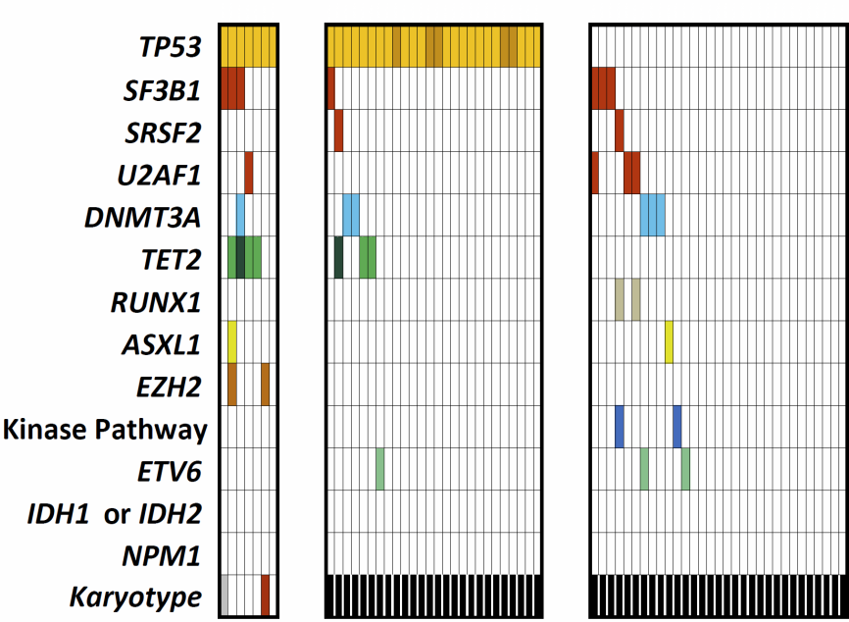
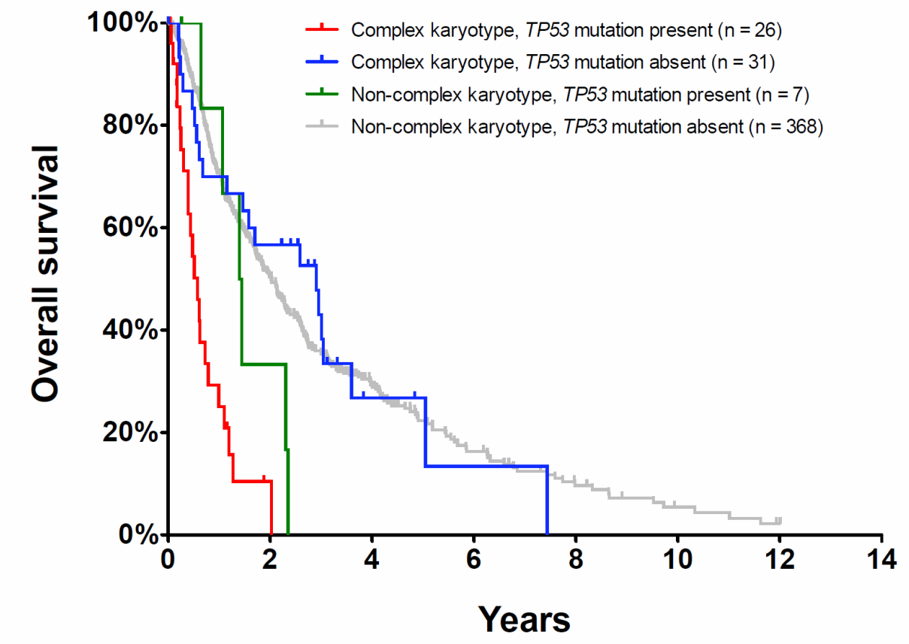
TP53 Mutations and Complex Karyotypes
TP53 Mutated
Complex Karyotype
The adverse prognostic impact of the complex karyotype is entirely
driven by its frequent association with mutations of TP53

Slide 51
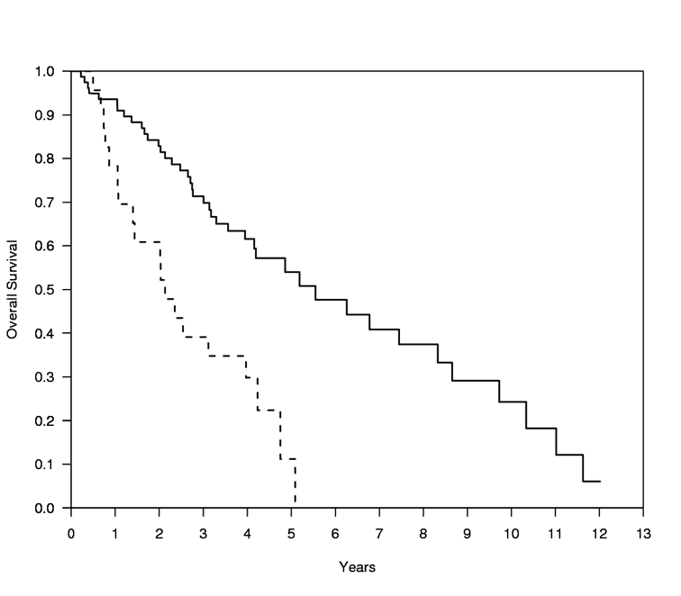
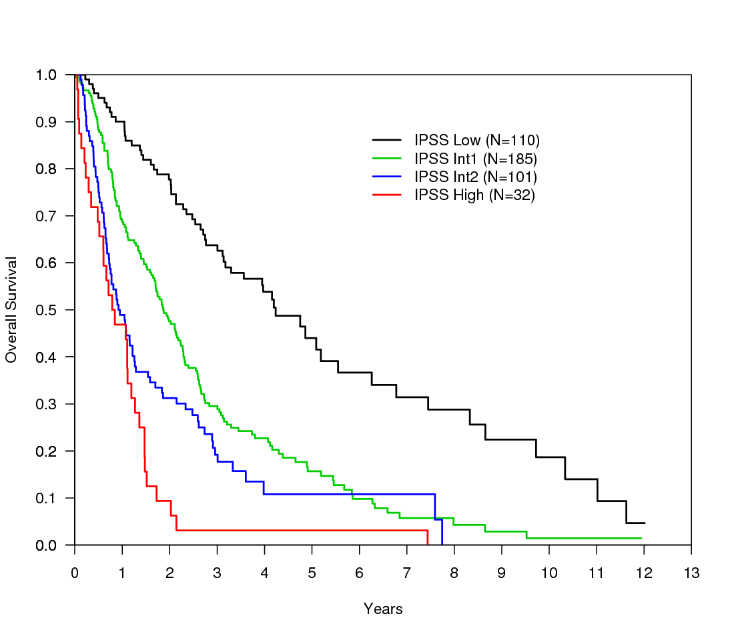
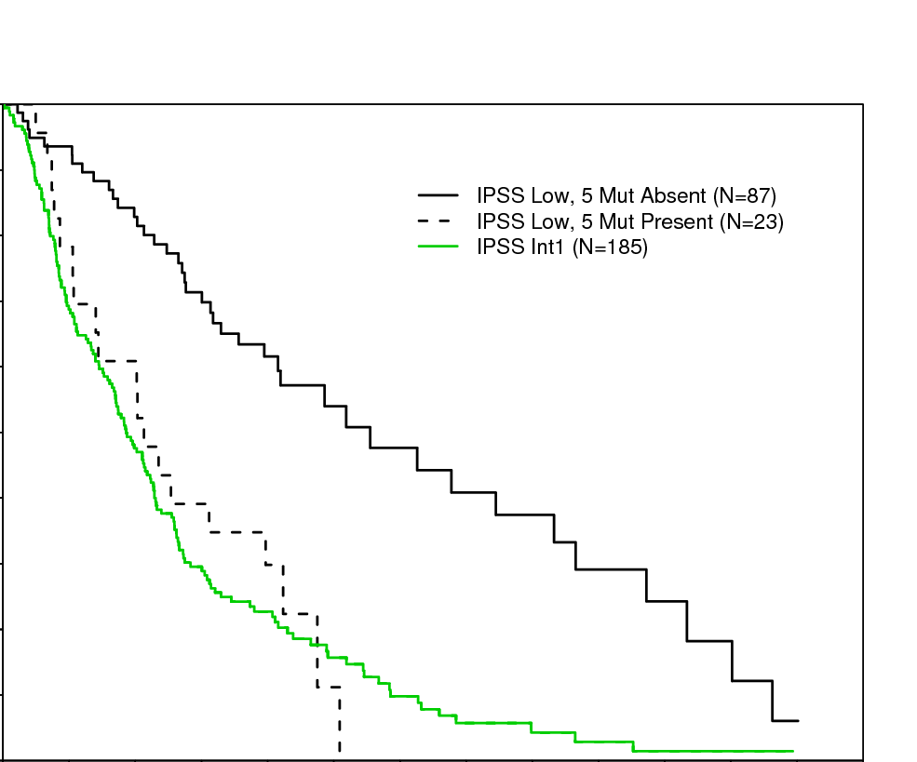




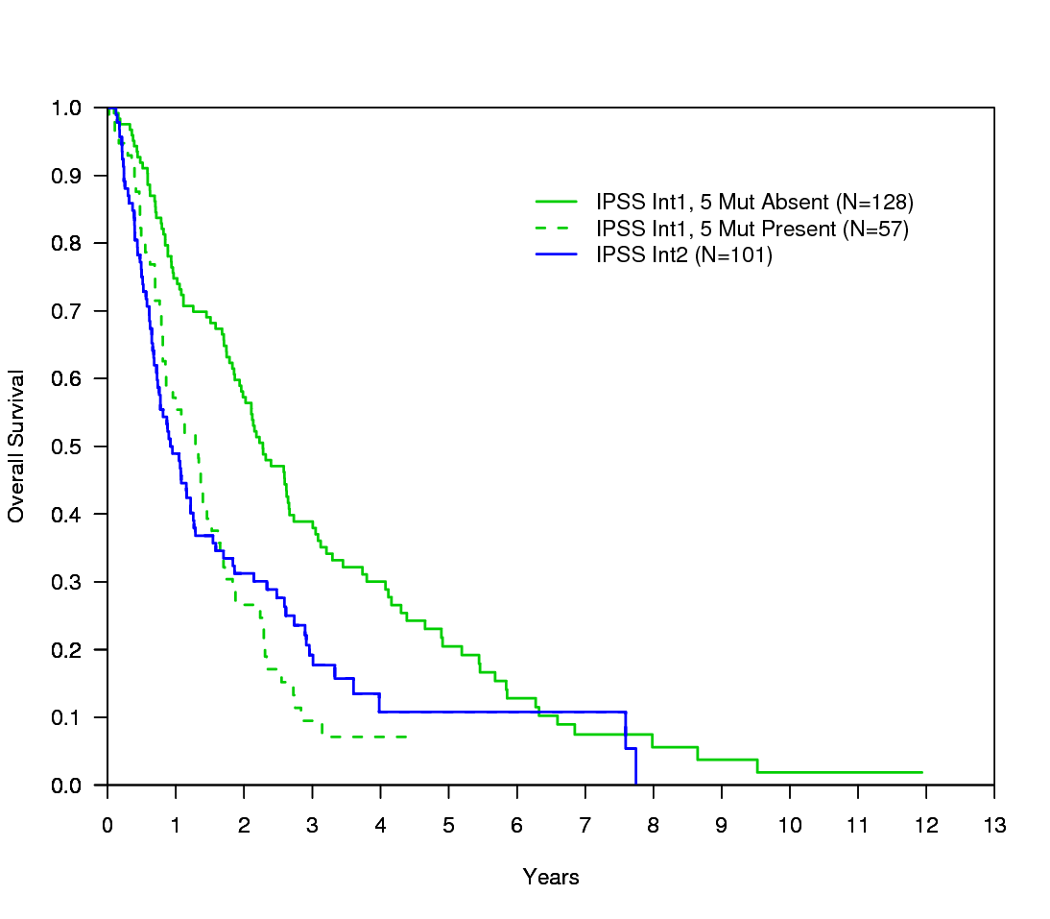
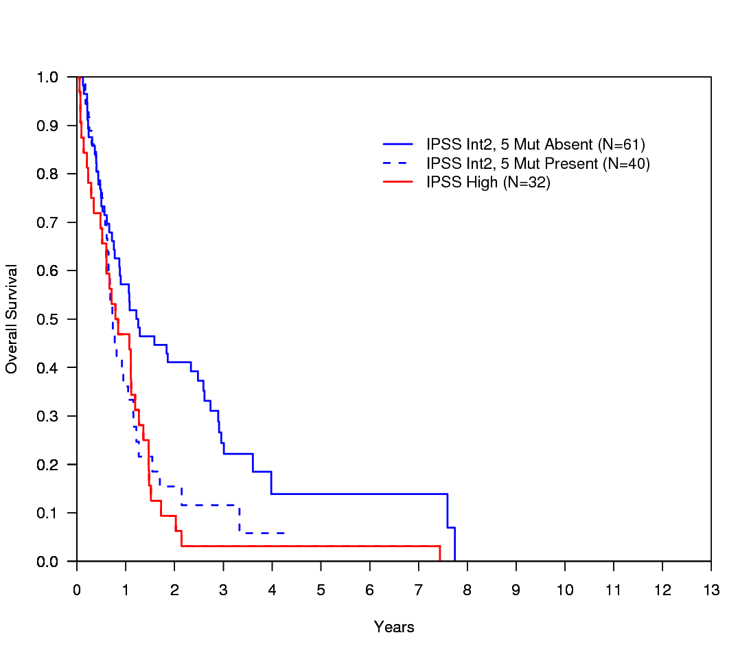
Impact of Mutations by IPSS Group
1.0
1.0
TP53
1.0
IPSS Low (n=110)
IPSS Int1 (n=185)
IPSS Int2 (n=101)
IPSS High (n=32)
IPSS Low Mut Absent (n=87)
IPSS Low Mut Present (n=23)
p < 0.001
IPSS Int1 (n=185)
IPSS Low Mut Absent (n=87)
IPSS Low Mut Present (n=23)
p < 0.001
0.9
0.9
IPSS Low (n=110)
0.9
0.8
0.8
0.8
0.7
0.7
0.7
0.6
0.6
0.6
0.5
0.5
ETV6
0.5
Overall Survival
Overall Survival
Overall Survival
0.4
0.4
0.4
0.3
0.3
0.3
0.2
0.2
ASXL1
0.2
0.1
0.1
0.1
0.0
0.0
0.0
0
1
2
3
4
5
6
7
8
9
10
11
12
13
0
1
2
3
4
5
6
7
8
9
10
11
12
13
0
1
2
3
4
5
6
7
8
9
10
11
12
13
Years
Years
Years
1.0
1.0
0.9
IPSS Int1 Mut Absent (n=128)
IPSS Int1 Mut Present (n=57)
p < 0.001
IPSS Int2 (n=101)
0.9
IPSS Int2 Mut Absent (n=61)
IPSS Int2 Mut Present (n=40)
p = 0.02
IPSS High (n=32)
EZH2
0.8
0.8
0.7
0.7
0.6
0.6
0.5
0.5
Overall Survival
Overall Survival
0.4
0.4
RUNX1
0.3
0.3
0.2
0.2
0.1
0.1
0.0
0.0
0
1
2
3
4
5
6
7
8
9
10
11
12
13
0
1
2
3
4
5
6
7
8
9
10
11
12
13
Bejar et al. NEJM. 2011;364:2496-506.
Years
Years

Slide 52
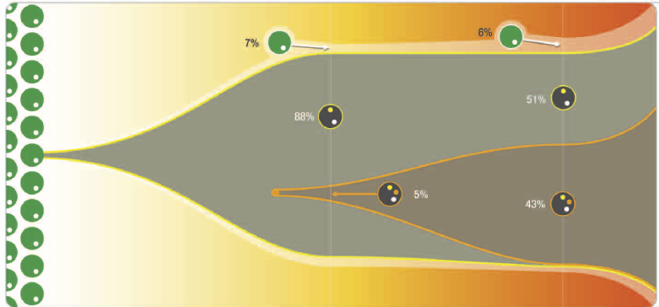
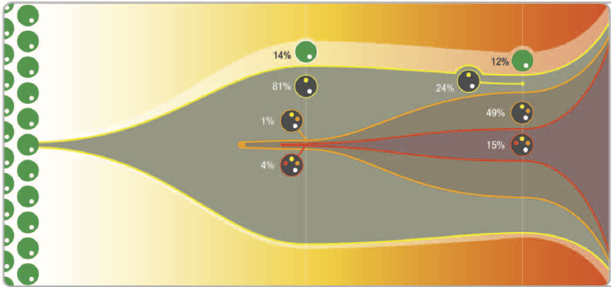
Tracking the Founder Clone
Walter MJ et al. NEJM 2012;366(12):1090-8.

Slide 53
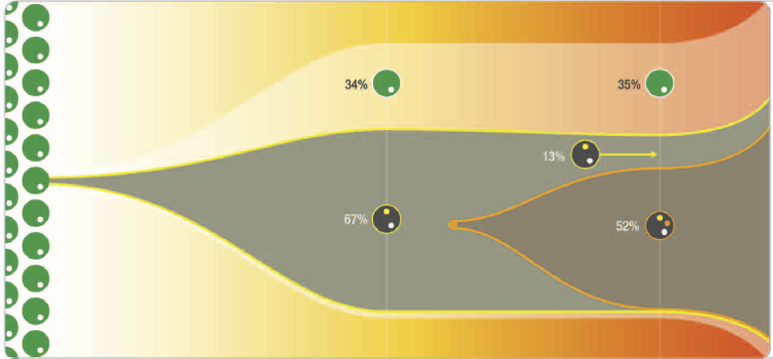

Clonal Evolution
Walter MJ et al. NEJM 2012;366(12):1090-8.

Slide 54




Clinical Sequencing and Banking
Targeted Massively Parallel Sequencing
Clinical
Information
Viable Cells
Tumor DNA/RNA
Germline DNA
Extensive Genotypic Annotation
Biorepository

Slide 55


Acknowledgements:
Bejar Lab - UCSD
Albert Perez
Brigham and Women’s
Ben Ebert
Allegra Lord
Ann Mullally
Anu Narla
Bennett Caughey
Bernd Boidol
Damien Wilpitz
Marie McConkey
DFCI / Broad
David Steensma
Donna Neuberg
Kristen Stevenson
Mike Makrigiorgos
Derek Murphy
Columbia University
Azra Raza Naomi Galili
MD Anderson Cancer Center
Guillermo Garcia-Manero
Hagop Kantarjian
Sherry Pierce
Gautam Borthakur
Memorial Sloan-Kettering
Ross Levine
Omar Abdel-Wahab

